Slide 1
Lecture 5 Linear Programming III

Slide 2
Agenda
Formulation Examples
Multi-period investment problem
Multi-period production problem
Network models
Transportation problem
Work assignment problem
Pricing advance purchase – application to Marketing
Aggregate planning problem – application to OSCM
Summary

Slide 3
Multi-period Investment: Planning for Tuition Expenses
Two parents want to provide for their daughter’s college education with some of the $80,000 they have recently inherited. They hope to set aside part of the money in the beginning of year 1 and establish an account that would cover the needs of their daughter’s college education, which begins four years from now (i.e., the beginning of year 5). Their estimate is that first-year college expenses will come to $24,000 and will increase $2000 per year during each of the remaining three years of college. The following investments are available to them. They would like to determine an investment portfolio for the coming eight years that will provide the necessary funds to cover their daughter’s anticipated college expenses with the smallest investment from the $80,000.
Investment Available for investment Matures Return at Maturity
A Every year in 1 year 5%
B In years 1, 3, 5, 7 in 2 years 11%
C In years 1, 4 in 3 years 16%
D In year 1 in 7 years 44%
For example. Investment B matures every two years with a return rate on investment 11%, and can be invested
in years 1, 3, 5, 7.

Slide 4
Planning for Tuition Expenses
1. What must be decided? What are the decision variables?
2. What measure should we use to compare alternative sets of decisions?
3. What restrictions limit our choices?

Slide 5
Planning for Tuition Expenses
4. Formulate the objective function:
5. Formulate the constraints:
6. Do we need non-negativity constraints?
7. Write down the total problem formulation:

Slide 6
Multi-period Production
Sailco Corporation must determine how many sailboats should be produced during each of the next four quarters (one quarter = three months). The demand during each of the next four quarters is as follows: first quarter, 30 sailboats; second quarter, 60 sailboats; third quarter, 75 sailboats; fourth quarter, 25 sailboats. Sailco must meet demands on time. At the beginning of each quarter, Sailco must decide how many sailboats should be produced during that quarter. For simplicity, we assume that sailboats manufactured during a quarter can be used to meet demand for that quarter and demand for future quarters. During each quarter, Sailco can produce up to 40 sailboats with regular-time labor at a total cost of $400 per sailboat. By having employees work overtime during a quarter, Sailco can produce additional sailboats with overtime labor at a total cost of $450 per sailboat. Each quarter, overtime production cannot exceed 20 sailboats.
At the end of each quarter (after production has occurred and the current quarter's demand has been satisfied), a carrying or holding cost of $20 per sailboat is incurred. At the moment, no boats are on-hand. Use linear programming to determine a production schedule to minimize the sum of production and inventory costs during the next four quarters.

Slide 7
Multi-period Production Formulation
Data for the Multi-period Production Problem
1. What must be decided? What are the decision variables?
2. What measure should we use to compare alternative sets of decisions?
3. What restrictions limit our choices?

Slide 8
Multi-period Production Formulation
4. Formulate the objective function:
5. Formulate the constraints:
6. Do we need non-negativity constraints?
7. Write down the total problem formulation:

Slide 9
Network Model: Transportation Problem
A furniture manufacturer, Furniture Max, has three warehouses (1, 2, 3) , and three retail stores (4, 5, 6). The following network diagram indicates the shipping routes and shipping costs. The values on the arcs indicate the per unit shipping costs required to transport furniture between the various cities. The supply of furniture at each warehouse is indicated by the number next to nodes 1, 2, and 3. The demand for furniture is indicated by the number next to the nodes 4, 5, 6. Formulate an LP to determine the least costly shipping plan for Furniture Max.
S:20
3
$40
S:30
1
$20
$20
D:10
$30
4
$30
6
D:40
$10
S: 40
2
$50
$30
5
$20
D: 30

Slide 10
Transportation Problem
1. What must be decided? What are the decision variables?
2. What measure should we use to compare alternative sets of decisions?
3. What restrictions limit our choices?
4. Formulate the objective function:

Slide 11
Transportation Problem
5. Formulate the constraints:
6. Do we need non-negativity constraints?
7. Write down the total problem formulation:

Slide 12
Network Model: Assignment Problem
Coach Kemppel is the coach of the Buchanan Swim Club’s co-ed team. Her team competes against other swim clubs, and a perennial question for the coach is how to organize the medley relay team. The medley relay requires each of four swimmers to swim a different stroke: butterfly, breaststroke, backstroke, and freestyle. The relay is the final event in the competition, and the outcome of the swim meet often depends on the performance of the relay team.
During practice, Coach Kemppel has asked each of her top four swimmers to try each of the four stokes, and she has tracked their times (in seconds), as shown in the following table.
Stroke
BF BR BK FR
Todd 38 75 44 27
Besty 34 76 43 25
Lee 41 71 41 26
Carly 33 80 45 30
With this information, Coach Kemppel is ready to assign swimmers to stokes in the relay race, but she can see that a lot of combinations are possible. Formulate a linear programming model to help Coach
Kemppel make this decision.
Notes:
My TAs.

Slide 13

Assignment Problem
Data for the Assignment Problem:
Decision Variables:
x_{ij} =1 assign swimmer i to stroke j
=0 not assign swimmer i to stroke j
i=A, B, C,D, j=1,2,3,4
Objective Function
t_{ij} is the time that swimmer i swims stroke j
Stroke
1(BF)
2 (BR)
3 (BK)
4 (FR)
Swimmer
A(Todd)
B (Besty)
C (Lee)
D (Carley)

Slide 14
Assignment Problem
Constraints:
x_{A1}+x_{B1}+x_{C1}+x_{D1}=1
x_{A2}+x_{B2}+x_{C2}+x_{D2}=1
x_{A3}+x_{B3}+x_{C3}+x_{D3}=1
x_{A4}+x_{B4}+x_{C4}+x_{D4}=1
x_{A1}+x_{A2}+x_{A3}+x_{A4}=1
x_{B1}+x_{B2}+x_{B3}+x_{b4} =1
x_{c1}+x_{c2}+x_{c3}+x_{c4} =1
x_{D1}+x_{D2}+x_{D3}+x_{D4} =1
Stroke nodes
Swimmer nodes
Notes:
No more than 2 jobs?

Slide 15
Application to Marketing
Pricing Advance Purchase
Airlines often use advance purchase discounts to maximize revenue by segmenting customers by their willingness to pay at different times.
An airline has two types of customers: high-value customers and low-value customers.
Let t represent the time in advance that a ticket is purchased and P represent price offered at that time.
The utility function of a high-value customer is
U_{H}= 800 – 20 t – P
The utility function of a low-value customer is
U_{L}= 350 – 5 t – P
Consumption
t
Purchase at Advance/Forward Price or Not
Purchase at Spot Price or Not

Slide 16
Advance Purchase
The low-value customers (e.g., leisure travelers) are less time sensitive and they are more likely to purchase in advance when price is low. The high-value customers (e.g., business travelers) are more time sensitive and they are likely to pay high spot price right before the departure time.
The airline wants to know how to set the advance purchase price and the spot price to segment the two types of customers and maximize revenue.
Suppose the airline knows that 30% of its customers are low-value customers and 70% of its customers are high-value customers

Slide 17
Advance Purchase
Define decision variables:
P₁= advance purchase price
P₂ =spot purchase price
t = timing of advance purchase
LP Formulation
MAX 0.3 P₁ + 0.7 P₂
s.t.
350 – 5 t – P₁ ≥ 350 – 5×0 – P₂ +1
(Low-value customer prefers advance)
350 – 5 t – P₁ ≥ 1
(Low-value customer purchases in advance)
800 – 20 t – p₁ +1 ≤ 800 – 20 ×0 – P₂
(high-value customer prefers spot)
1 ≤ 800 – 20 ×0 – P₂
(high-value customer purchases at spot)
p₁, p₂, t ≥ 0 and integers
The optimal Solution
Charge $199 for a 30 day advance and $798 for spot purchase

Slide 18
Aggregate Planning Problem
During the next 4 months, the SureStep Company must meet (on time) the following demands for pairs of shoes:
At the beginning of the first month, 1500 pairs of shoes are on hand, and SureStep has 100 workers.
Month | Demand of shoes (pairs)
1 | 3,000
2 | 5,000
3 | 2,000
4 | 1,000
18
Notes:
18

Slide 19
Aggregate Planning Problem
A worker is paid $1500 per month. Each worker can work up to 160 hours a month before he or she receives overtime. A worker can work up to 20 hours of overtime per month and is paid $13 per hour for overtime labor.
It takes 4 hours of labor and $15 of raw material to produce a pair of shoes.
At the beginning of each month, workers can be hired or fired. Each hired worker costs $1600, and each fired worker costs $2000. At the beginning of each month, a holding cost of $3 per pair of shoes left in inventory is incurred. All of the production in a given month can be used to meet that month’s demand.
SureStep wants to use LP to determine its optimal production schedule and labor policy.
19
Notes:
19

Slide 20
Aggregate Planning Problem
Analysis
20
Notes:
20

Slide 21
Aggregate Planning Problem
Formulation
21
Notes:
21

Slide 22
Tips for Different Types of LP Applications
Product Mix
production constraints for each step of processing
May also have constraints on amount of labor
Work Scheduling
Remember that the variable should be defined as the number of workers who start work on day i (or group i, shift i, etc…)
Blending
Often , the decision variable should be defined as the amount of each ingredient in each mix
Certain percentages were needed such that various mixture amounts were achieved
Multi-period Financial Investment
Cash in-flow ≥ Cash out-flow for each time period
Multi-period Production Planning
The key is to remember our accounting:
Ending inventory = Beginning inventory + Production
- Demand/Sales
Network Models (transportation, assignment)
Decision variables: arcs in the network
Constraints: nodes (material balance: material in ≥ material out)

Slide 23
Summary
Linear Programming Formulation
Decision variables
Linear objective function
Linear constraints
Sign restriction
Applications
Product mix
Work scheduling
Blending
Multi-period investment
Multi-period production
Network models
Transportation
Work assignment
Solution
Simplex Method
Excel solver
Graphical LP

Slide 24
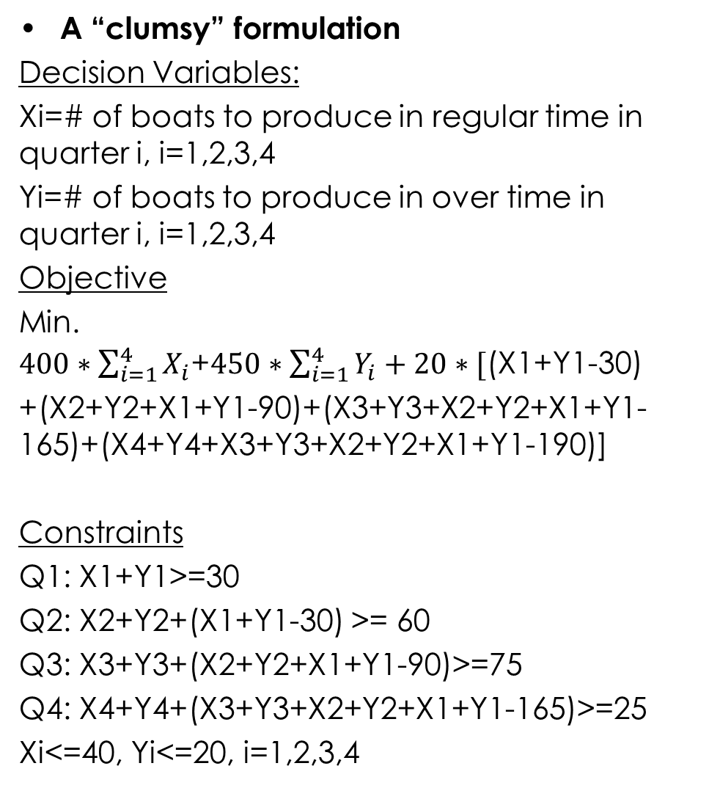
Multi-Period Production
A “clumsy” formulation
Decision Variables:
Xi=# of boats to produce in regular time in quarter i, i=1,2,3,4
Yi=# of boats to produce in over time in quarter i, i=1,2,3,4
Objective
Min. $400∗\sum_{i=1}^{4}{X_{i}}$+$450∗\sum_{i=1}^{4}{Y_{i}}+20∗\text{[}\text{(}\text{X}\text{1+}\text{Y}\text{1−30)}$
+(X2+Y2+X1+Y1-90)+(X3+Y3+X2+Y2+X1+Y1-165)+(X4+Y4+X3+Y3+X2+Y2+X1+Y1-190)]
Constraints
Q1: X1+Y1>=30
Q2: X2+Y2+(X1+Y1-30) >= 60
Q3: X3+Y3+(X2+Y2+X1+Y1-90)>=75
Q4: X4+Y4+(X3+Y3+X2+Y2+X1+Y1-165)>=25
Xi<=40, Yi<=20, i=1,2,3,4
[Material in-flow = Material out-flow]

Slide 25
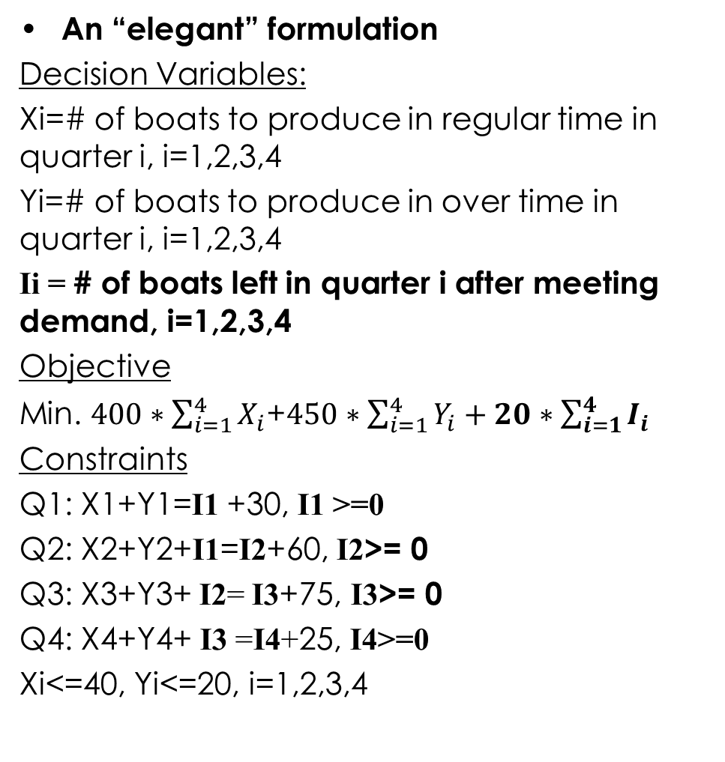
Multi-Period Production
An “elegant” formulation
Decision Variables:
Xi=# of boats to produce in regular time in quarter i, i=1,2,3,4
Yi=# of boats to produce in over time in quarter i, i=1,2,3,4
Ii = # of boats left in quarter i after meeting demand, i=1,2,3,4
Objective
Min. $400∗\sum_{i=1}^{4}{X_{i}}$+$450∗\sum_{i=1}^{4}{Y_{i}}+20∗\sum_{i=1}^{4}{I_{i}}$
Constraints
Q1: X1+Y1=I1 +30, I1 >=0
Q2: X2+Y2+I1=I2+60, I2>= 0
Q3: X3+Y3+ I2= I3+75, I3>= 0
Q4: X4+Y4+ I3 =I4+25, I4>=0
Xi<=40, Yi<=20, i=1,2,3,4

